Slide 1
BFX AT-100 Ethernet fail FA report
Prepare by: PE – JUSTIN
Date: 2025/04/09

Slide 2
Problem Description
Issue Description (5W1H)
When | 2025-Jan-10
Who | SH Son
Where | ALT customer side, Location : SK networks warehouse, Anseong, Korea.
What | ALT customer complain 1pc DOA T99X171.00 Ethernet fail
Why | This issue follow U1_S905X2 (MPM:S905X2-B, P/N: 002.02753.005, DC: 20240617, Vendor: AMLOGIC component
How | NG product access internet fail : S/N range: 2149688001202404449199
How much | 1pcs / 600.000 pcs ~ 0.000166% ( Qty production from Jan/2024 to Dec/2024 )

Slide 3
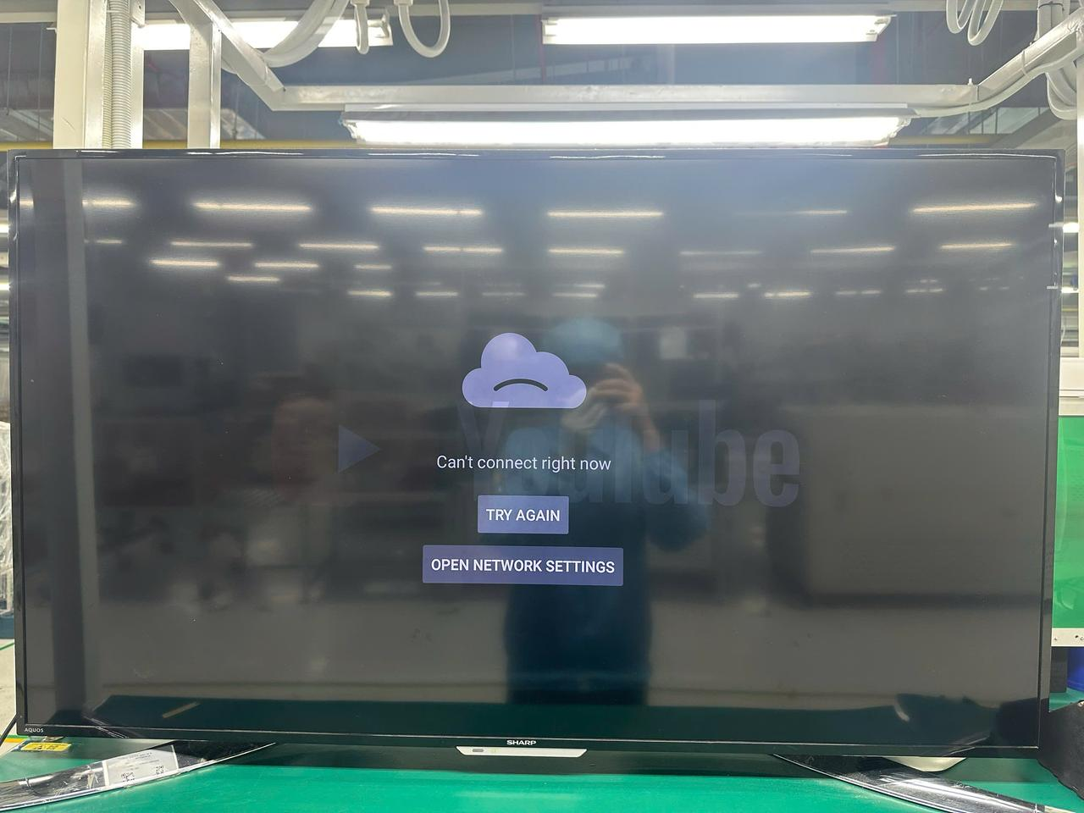
Confirm Fail Symptom
Customer feedback:
ALT customer feedback Ethernet doesn’t work (S/N: 2149688001202404449199 )
Visual check -> No found abnormal.
Update check -> No found abnormal
+ By USB and By USB burning tools
Factory confirm:
Re-test OBA: NG product access internet fail
Product access internet fail
Summary:
NG product access internet fail

Slide 4
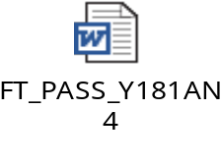
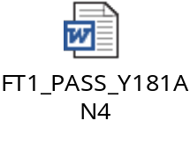
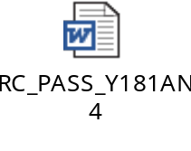
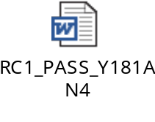
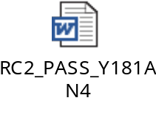
Production History Data Checking
T Level data (SMT)
SN | Test Station
Y181AN4 | SMTLOADING | TURNPCB | SPI2 | AOI_2 | INSP | PCB_STOCKIN
 | 11/2/2024 14:41 | 11/3/2024 13:09 | 11/4/2024 14:30 | 11/4/2024 14:48 | 11/4/2024 14:58 | 11/4/2024 18:23
Dot Level data (FATP )
S/N range | Test Station
2149688001202404449199 | UK | FT | FT1 | RC | RC1 | RC2
 | 11/12/2024 13:43 | 11/12/2024 13:49 | 11/12/2024 13:57 | 11/12/2024 14:03 | 11/12/2024 14:15 | 11/13/2024 13:29
Test logs | UK test haven’t logs test
Summary:
- This unit has PASSED normally SMT and FATP.
- Shipping date: 2024/11/18 16:44:36

Slide 5
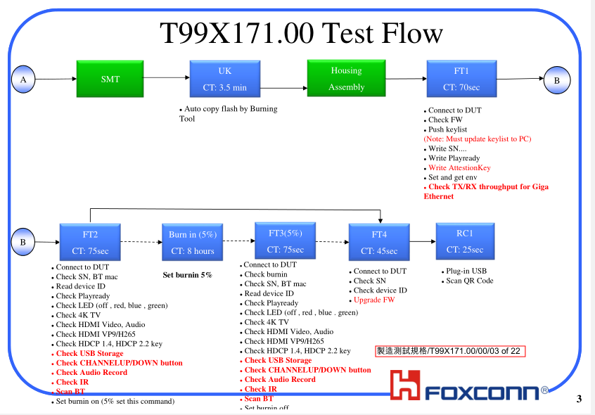


Coverage checking
Re-test RC1, OBA, RC2 with customer image:
STATION | RC1 | OBA | RC2
Result | PASS | FAIL | N/A( fail at OBA not test RC2)
Test log |  |  | N/A
Summary:
- FATP don’t test internet access issue
- OBA NG board access internet fail. This issue only cover by OBA station

Slide 6
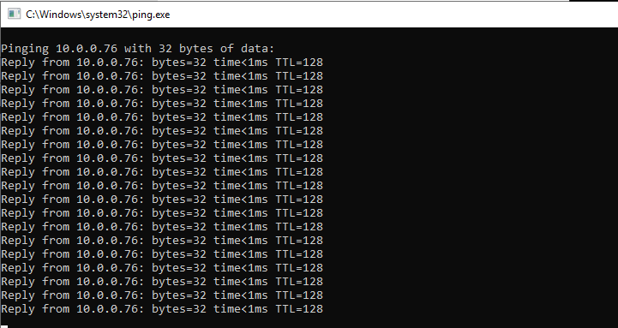
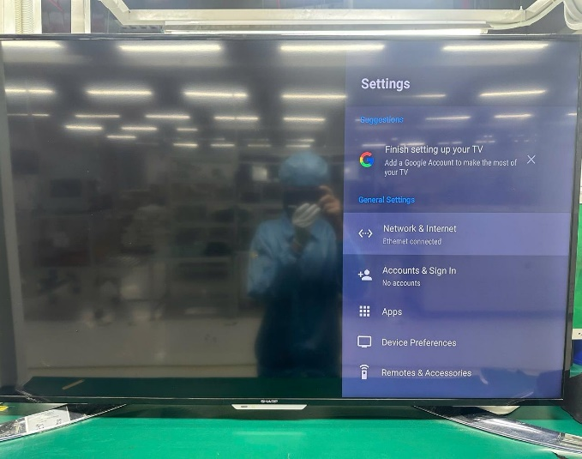
Ethernet connect verification
Ping product result:
1. NG product boot up normally
2. Display check Ethernet connect normally
3. Use PC ping to ip (10.0.0.76) NG product through internet router normally
Ping DUT from PC normally
PC
Ip: 10.0.0.100
Ip: 10.0.0.76
Power 5V2A
DUT
ETH
HDMI
Internet Router
Summary:
PC ping ip DUT (10.0.0.76) normally via Internet Router
PC can ping NG product normally, but can’t internet access
Ip: 10.0.0.1
OBA station

Slide 7
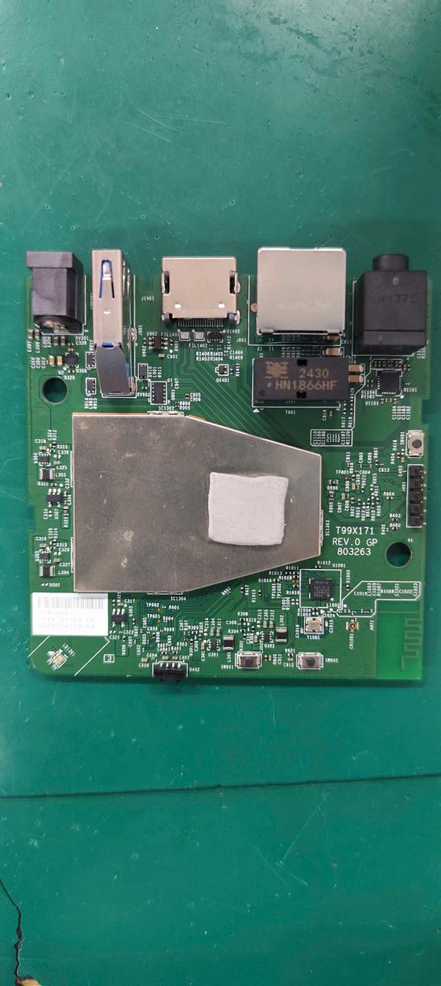


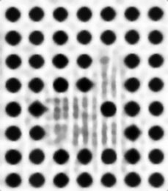


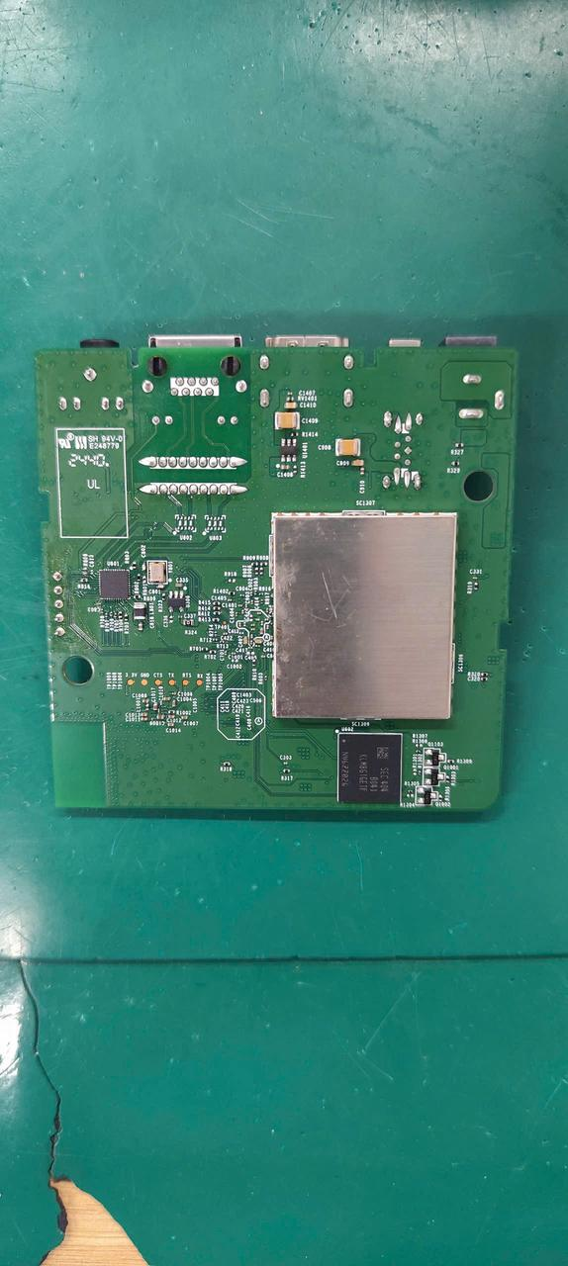




VI and X-ray Checking
Visual inspection normally
X-ray check:
FIL1401, FIL1402
U1 | U602 | U1001 | FIL1401 | FIL1402
U503 | U504 | U505 | U602
U504
U1
U503
U1001
U506
Summary :
- VI and X-ray visual inspection → Not found abnormal
U505
U602

Slide 8
Power supply measurement
Measurement power supply result:
Measure impedance & voltage NG board
Location | Description | NG board |  |  | OK sample
 |  | Impedance | VF | Voltage power | Impedance | VF | Voltage power
R328 | PP_PWR_IN | 3.33K | 0.503 | 5.042 | 3.260K | 0.504 | 4.992
L303 | P1V2 | 169.5 | 0.084 | 1.215 | 182 | 0.089 | 1.217
R325 | P2V5 | 21.37K | 0.390 | 2.512 | 21.61K | 0.392 | 2.506
L304 | P3V3 | 20.2K | 0.35 | 3.330 | 19.59K | 0.35 | 3.323
C322 | eMMC_VDDQ | 23.2K | 0.42 | 3.328 | 23.14K | 0.416 | 3.326
L301 | VDDCPU | 61.9 | 0.071 | 0.836 | 66.1 | 0.075 | 0.839
L302 | VDD_EE | 16.3 | 0.015 | 0.841 | 35.5 | 0.037 | 0.840
L801 | ETH_DVDD10 | 1.92K | 0.31 | 1.014 | 1.952K | 0.299 | 1.009
Summary:
- No found abnormality

Slide 9
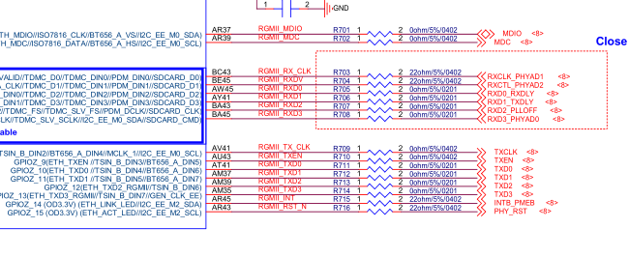
Ethernet block impedance measurement
Measurement impedance of Ethernet signal
Measure impedance NG board
Signal pin | Location | NG board | OK sample
RGMII_MDIO | R701 | 20.58K | 20.56K
RGMII_MDC | R702 | 2.652M | 2.656M
RGMII_TX_CLK | R709 | 2.618M | 2.615M
RGMII_TXEN | R710 | 2.642M | 2.640M
RGMII_TXD0 | R711 | 2.638M | 2.636M
RGMII_TXD1 | R712 | 2.615M | 2.612M
RGMII_TXD2 | R713 | 2.642M | 2.641M
RGMII_TXD3 | R714 | 2.645M | 2.639M
RGMII_INT | R715 | 27.44K | 27.39K
RGMII_RST_N | R716 | 27.44K | 27.36K
RGMII_RX_CLK | R703 | 3.992K | 4.012K
RGMII_RXDV | R704 | 4.070K | 4.015K
RGMII_RXD0 | R705 | 3.998K | 4.008K
RGMII_RXD1 | R706 | 21.12K | 21.16K
RGMII_RXD2 | R707 | 21.14K | 21.13K
RGMII_RXD3 | R708 | 21.19K | 21.16K
Summary:
- Measure impedance no found abnormality

Slide 10
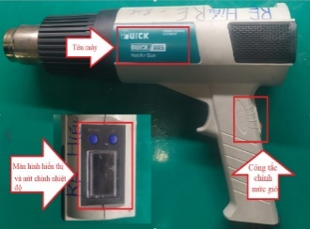
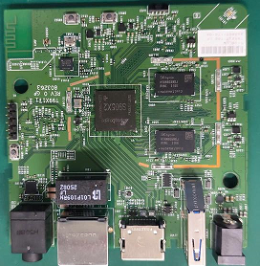
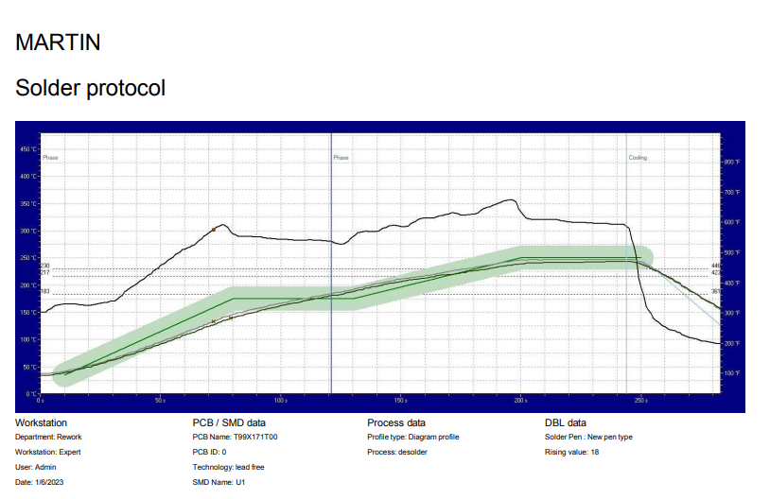
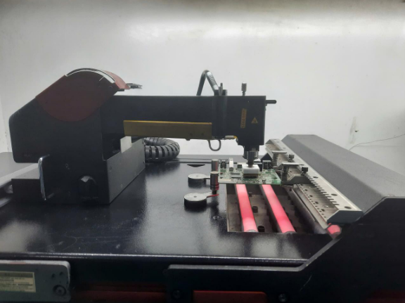
Component humidity verification
Material’s moisture sensitivity verify result:
Temperature | Time | Internet access result
180°C | 30s | Still fail
200°C | 30s
220°C | 30s
Re-solder | NA
QUICK 885
Re-solder CPU: U1 verify result:
T99X171.00 U1 profile
BGA machine model: Mafi538
Summary:
- This issue not follow MSD and solderability issue

Slide 11











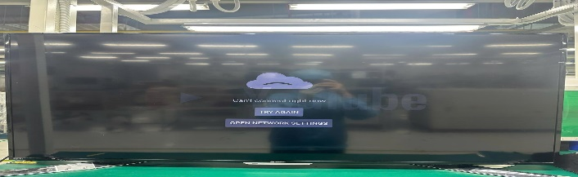

Swap Component verification
Swap U1 verification between NG and OK material and re-test FATP result:
Swap items | Test Station
 | UK | FT | FT1 | RC | RC1 | OBA | RC2
OK board + NG U1 (#2C9811AD1B8D) | UK test haven’t logs test | PASS: | PASS: | PASS: | PASS: | Fail: | N/A
NG board + OK U1(#2C9811AAE701) |  | PASS: | PASS: | PASS: | PASS: | Pass: | Pass
Swap U1 verification between NG and OK material internet access result:
NG Board Items | Internet access
OK board + OK U1 | Internet access OK
NG board + NG U1 | Not internet access
NG board + OK U1 | Internet access OK
OK board + NG U1 | Not internet access
Not internet access
Internet access OK
Summary :
- FATP can’t cover this issue
- This issue follow U1_S905X2 (MPM:S905X2-B, P/N: 002.02753.005, DC: 20240617, Vendor: AMLOGIC) component

Slide 12
History checking
Fail history checking of 2024y:
- 2024 year BFX AT-100 total production q’ty: 600.000 pcs. Internet access fail rate: 0/600.000 pcs ~ 0%
- OBA testing: 8370 pcs. Internet access fail rate: 0/8370 pcs ~ 0%
- Total shipment q’ty: 600.000 pcs, DOA Internet access fail rate: 1/600.000 pcs~0.000166%
P/N: 002.02753.005 use history of 2024y:
PN:002.02753.005 use history checking
No.# | DC | Total q'ty | Total q’ty used | Remaining | Fail q’ty | Vendor | Defect rate | Remark
1 | 20240129 | 42986 | 42986 | 0 | ~0 | AMLOGIC | ~0%
2 | 20240325 | 39943 | 39943 | 0 | ~0 | AMLOGIC | ~0%
3 | 20240415 | 50658 | 50658 | 0 | ~0 | AMLOGIC | ~0%
4 | 20240603 | 48000 | 48000 | 0 | ~0 | AMLOGIC | ~0%
5 | 20240617 | 9275 | 9275 | 0 | ~1 | AMLOGIC | ~ 0.01% | Detect DOA board
6 | 20240603 | 24900 | 24900 | 0 | ~0 | AMLOGIC | ~0%
Summary:
Only DC: 20240617 ~ 9275pcs have 1pc DOA fail internet access
Remaining ~ 0pcs

Slide 13
Change new CPU reliability test
Run-in and ORT verify of Ng board + OK U1 (#2C9811AAE701):
No.# | Product | Thermal shock 6pcs (-20°C in 30 minutes to 70°C in 30 minutes) | Internet access result | Run-in 48 hour
1 | DOA sample | OK | PASS | PASS
2 | Sample 1 | OK | PASS | PASS
3 | Sample 2 | OK | PASS | PASS
4 | Sample 3 | OK | PASS | PASS
5 | Sample 4 | OK | PASS | PASS
6 | Sample 5 | OK | PASS | PASS
Summary :
- Run-in power on (4 hour) ➔ No found abnormality
- Thermal shock (-20°C in 30 minutes to 70°C in 30 minutes) * 20 cycles ➔ No found abnormality
- Run-in after thermal shock (48 hour). Due date: 04/13
➔ Change new CPU: U1 can solve this issue

Slide 14
Summary
No.# | Items | Result | Owner
1 | Fail symptom | Can’t internet access | PE: Justin, PQE: Rachel, TE: Jones
2 | Production history | Shipping date: 2024/11/18 | PQE: Rachel
3 | Coverage | FATP can’t cover this issue | PE: Justin
4 | VI and X-ray | Normally | ME: Wen.tai
5 | Power supply measurement | Normally | PE: Justin
6 | Solder heat verify | Not follow component humidity issue | PE: Justin
7 | Swap verify this issue | Follow U1_S905X2-B (MPM:S905X2-B, P/N: 002.02753.005, DC: 20240617, Vendor: AMLOGIC) component | PE: Justin, SQE: Mia
8 | 002.02753.005, DC: 20240617 history | No remaining | PE: Justin, SQE: Mia
9 | Reliability test | Normally | PE: Justin, PQE: Rachel
Action:
Co-work with RD/TE how to cover this issue. Owner: PE: Justin, PQE: Rachel. Due date: 25/04/25
Send NG component to AMLOGIC vendor further FA. Owner: PE: Justin, SQE: Mia. Due date: 25/05/20

